Slide 1
ZING

Slide 2
1
TECH STACK

Slide 3

TECH STACK USED
MONGODB - 4.4.0
EXPRESSJS – 4.17.2
ANGULAR – 13.2.1
NODEJS – 16.13.2(LTS)

Slide 4
2
FEATURES

Slide 5
FEATURES
USER DASHBOARD
View all products from all sellers at a glance.
Add Products to cart once the user is logged in.
View product details.
View Cart.
Delete items from cart.
Make Payment.
SELLER DASHBOARD
View statistics like Total Orders, Total orders shipped, Total products shipped.
Add New Products.
View All the products sold by them.
Edit the product details like title, price and description
All the functionalities of the user.

Slide 6
3
ARCHITECTURE DIAGRAM

Slide 7
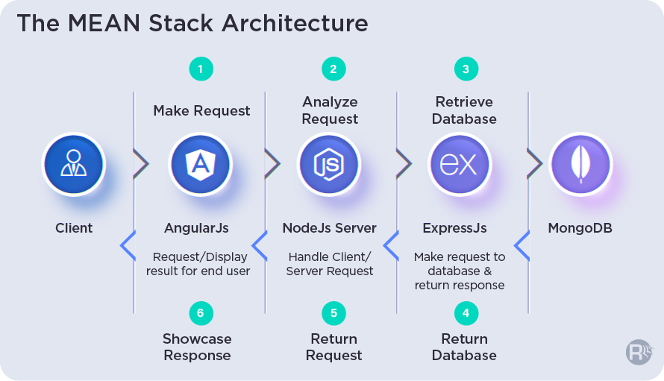
ARCHITECTURE DIAGRAM

Slide 8
4
COMPONENT DIAGRAM

Slide 9
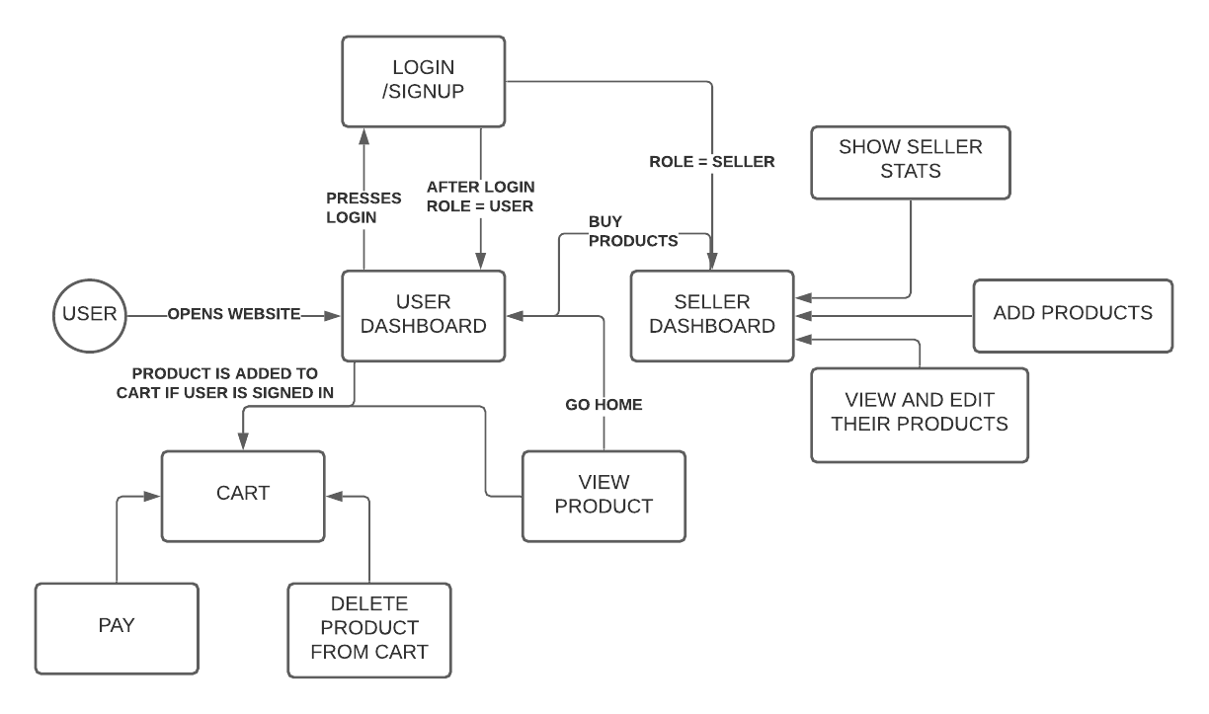
COMPONENT DIAGRAM

Slide 10
5
PROJECT OVERVIEW

Slide 11
PROJECT OVERVIEW
In this Case Study I aimed at making a fully functional Ecommerce website. A customer can add products to cart and purchase them while a seller can see the stats in real time, add products, update products as well as any normal user add products to cart and purchase them.

Slide 12
DONE BY
AAKAR MUTHA

